Slide 1
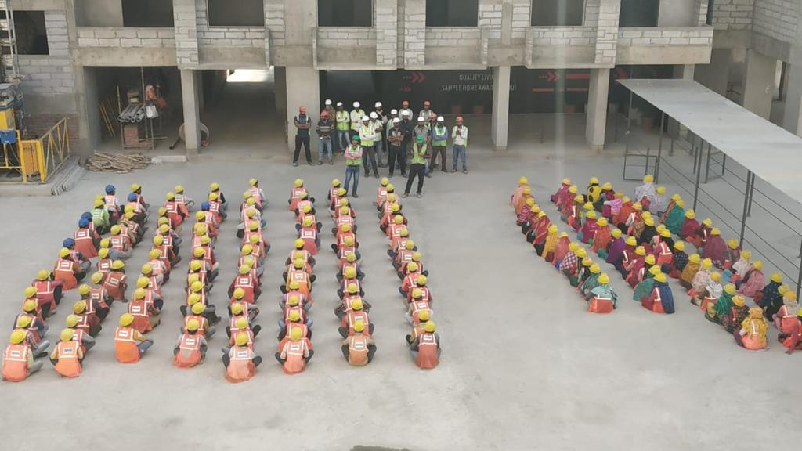
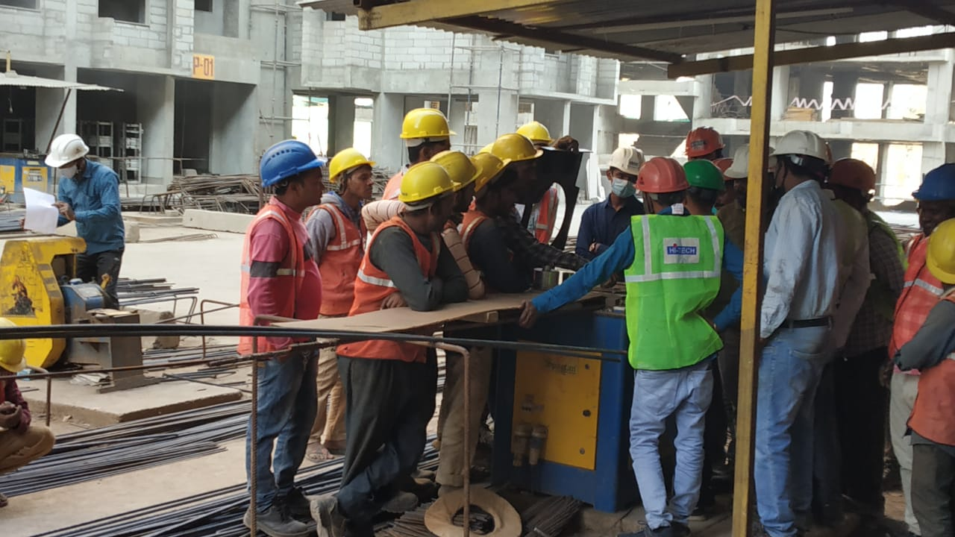
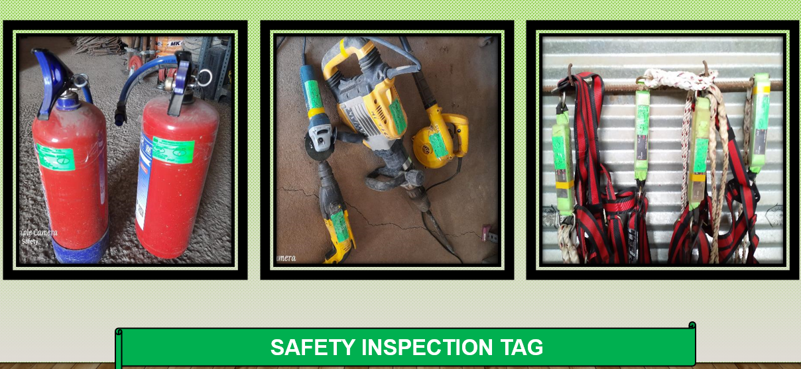
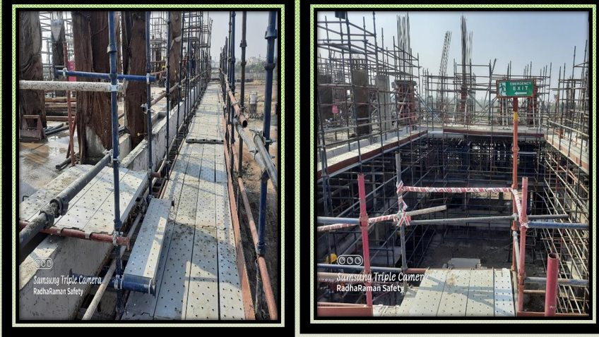

PHOTOS OF GOOD PRACTICES
Mass TBT
Job specific training
Proper access/route
PHOTOS OF GOOD PRACTICES
PROJECT REVIEW MEETING – SAFETY REVIEW

Slide 2
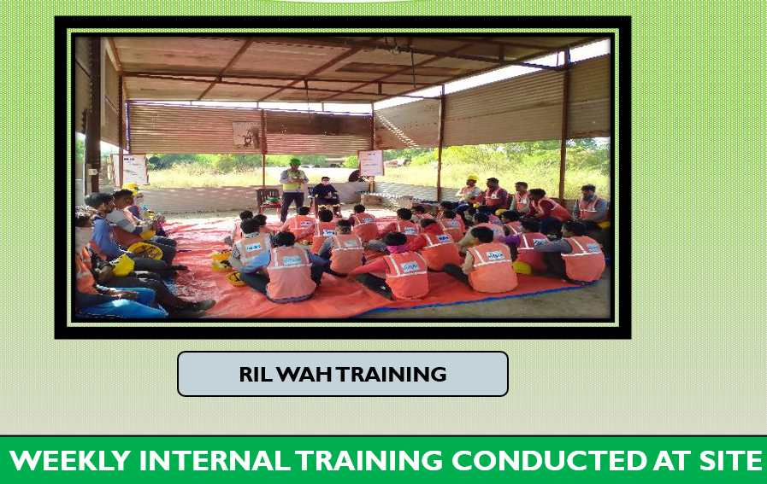
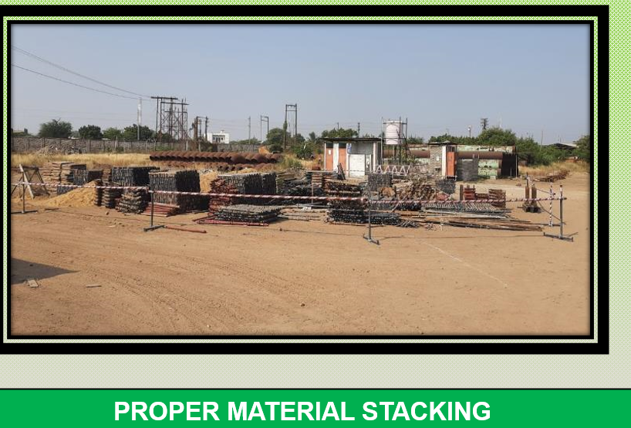
PHOTOS OF GOOD PRACTICES
PROJECT REVIEW MEETING – SAFETY REVIEW

